Slide 1

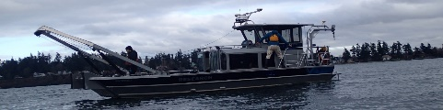

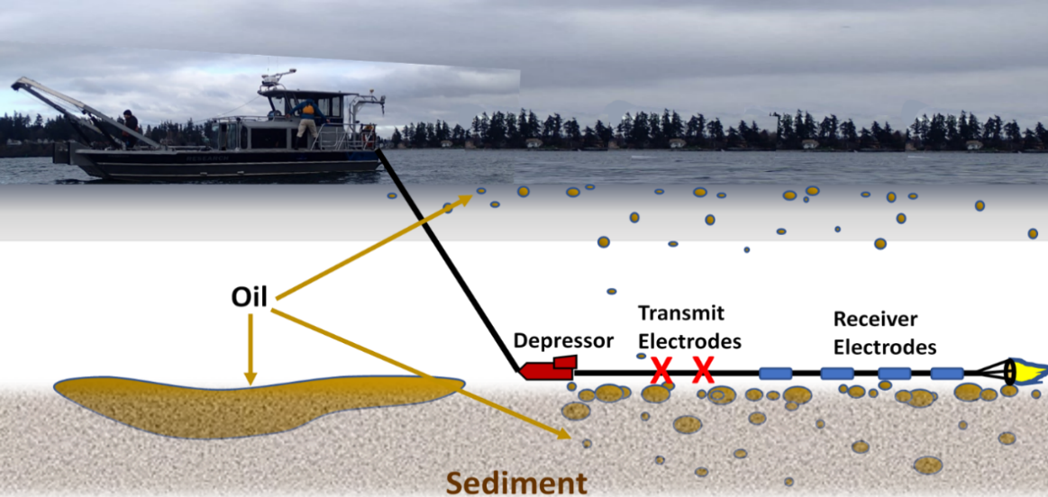
ADAC Annual Meeting
Marine IP - Detection and Mapping of Oil Under Ice: A Ruggedized Field Kit
PI Dr. Scott Socolofsky, Texas A&M University
Researcher Kari Walker, IntelliSense Marine LLC

Slide 2
ADAC Project: Marine Induced Polarization Methods for the Detection and Mapping of Oil in an Arctic Marine Oil Spill – Ruggedized Field Kit Production and Testing
ADAC Annual Meeting: 21 April 2022
• Project Principal Investigator: Dr. Scott Socolofsky, Texas A&M University
• Supporting Team:
  Ms. Kari Walker and Mr. Kevin Hand, IntelliSense Marine
  Mr. Art Wright, Mr. Jay Radler and Mr. Todd Stedman, Induced Polarization Associates
  Mr. Nathan Lamie, Lead Engineer/Facility Operator, Cold Regions Research and Engineering Laboratory, U.S. Army Corps of Engineers
• Project Champion: LCDR Clifton Graham, CG-MER

Slide 3
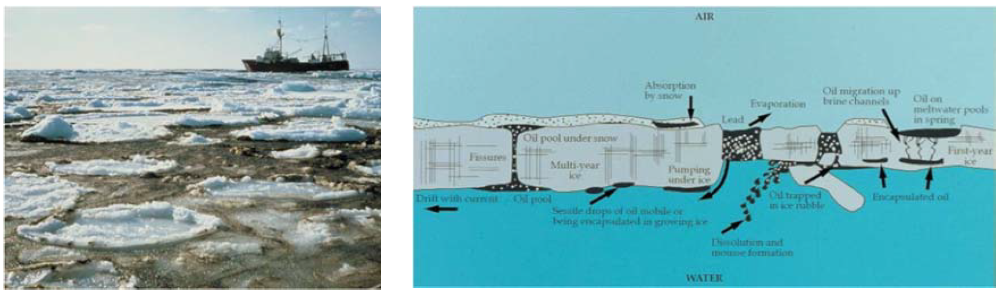
Marine IP: Project Description and Baseline
ADAC Annual Meeting: 21 April 2022
Project Description: Federal on-scene spill responders need remote sensing tools to detect and map oil in the open-Arctic ocean, broken ice fields, as well as oil under and within ice.
This research effort will build and test hardware and software for an Arctic-Ready Marine Induced Polarization (Marine IP) System, which locates and assesses polarizable mineral and particle distributions - such as hydrocarbons - in water, ice and in sediment.
Baseline: Marine IP has shown strong promise to serve as a tool for the detection and mapping of oil under ice and in seafloor sediment. A robust, Arctic-Ready Marine IP system needs to be developed to mitigate the harsh conditions of the Arctic.

Slide 4
Marine IP: Method
ADAC Annual Meeting: 21 April 2022
Oil on and within seafloor sediment:
A cable is towed behind a vessel
Transmit electrodes emit a controlled electrical current
Receiver electrodes measure changes in the return signal caused by substances encountered
Oil
Transmit Electrodes
Receiver Electrodes
Depressor

Slide 5
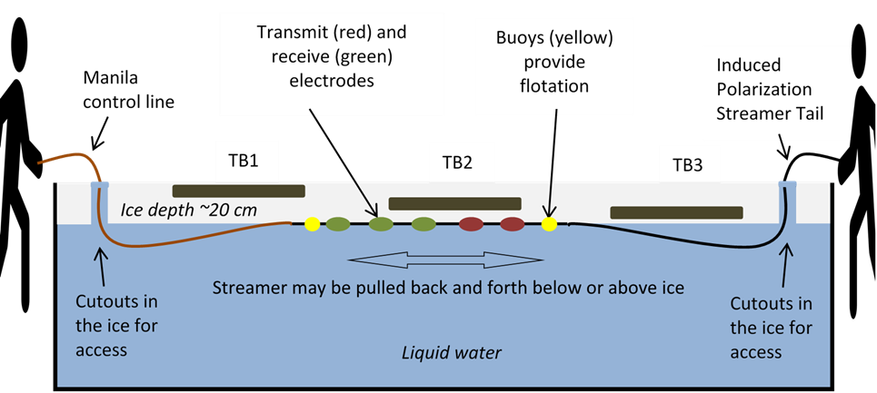
Marine IP: Method
ADAC Annual Meeting: 21 April 2022
Oil-Under-Ice testing: CRREL Testing Facility
A cable streamed under tank ice
Transmit electrodes emit a controlled electrical current
Receiver electrodes measure changes in the signal due to substances encountered
Transmit (red) and receive (green) electrodes
Induced Polarization Streamer Tail
Induced Polarization Streamer Tail
Buoys (yellow) provide flotation
Control line
Test Area
Test Area
Test Area
Water at 0.25 Salinity

Slide 6
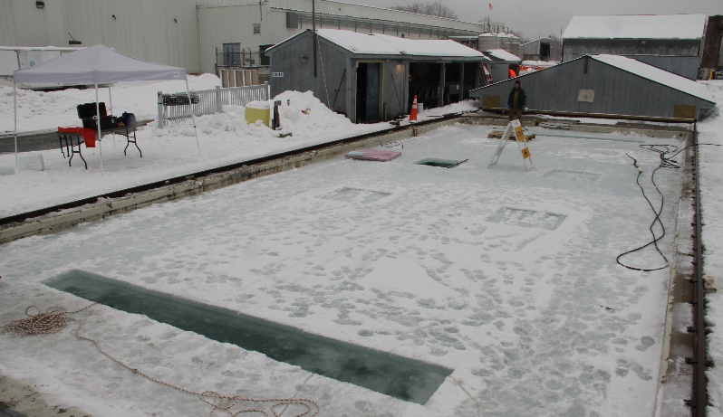
Marine IP: Method
ADAC Annual Meeting: 21 April 2022
CRREL Testing Facility
Oil-Under-Ice testing: CRREL Testing Facility:
Study design included 6 test scenarios:
  Oil under solid ice
  Oil encapsulated within ice
  Oil in pockets under broken and refrozen ice.
  Oil in broken ice
  Controls: Broken ice and solid ice, no oil added
Transmit (red) and receive (green) electrodes
Induced Polarization Streamer Tail
Buoys (yellow) provide flotation
Control line
Test Area
Test Area
Test Area
Water at 0.25 Salinity

Slide 7
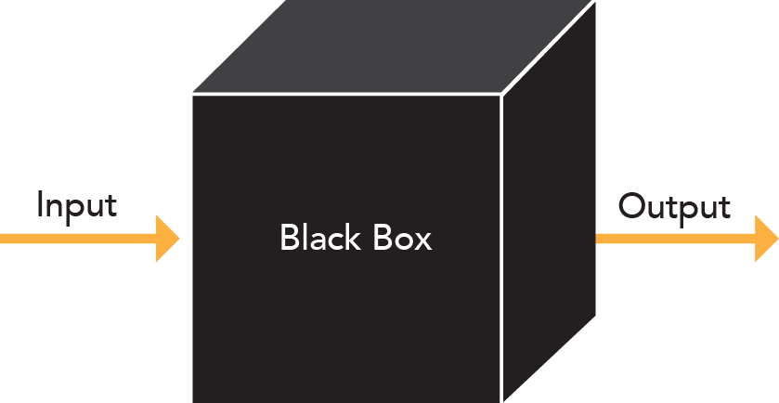
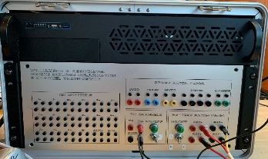
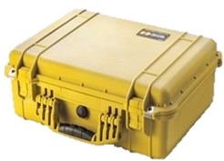
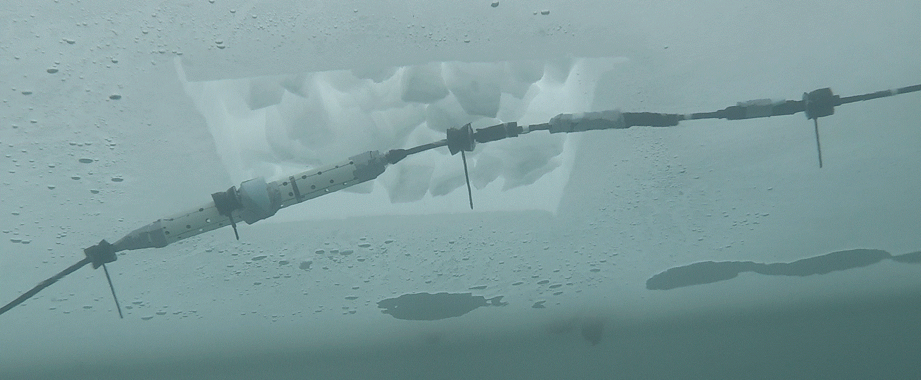
Marine IP: Progress on Research Objectives
ADAC Annual Meeting: 21 April 2022
Project Objectives:
Continue to validate Marine IP as a viable means to detect oil within ice and broken ice. Complete
Develop and build the hardware, firmware and software for an Arctic-Ready Marine IP System that can withstand the harsh environment of the Arctic: Complete
Test the Arctic-Ready Marine IP System in an offshore, towed scenario: Complete
Test the Arctic-Ready Marine IP System in a simulated Arctic environment scenario (CRREL): Complete
Further identify possible Marine IP deployment mechanisms for characterization, with emphasis on AUVs: Complete
Old Enclosure
New Enclosure

Slide 8
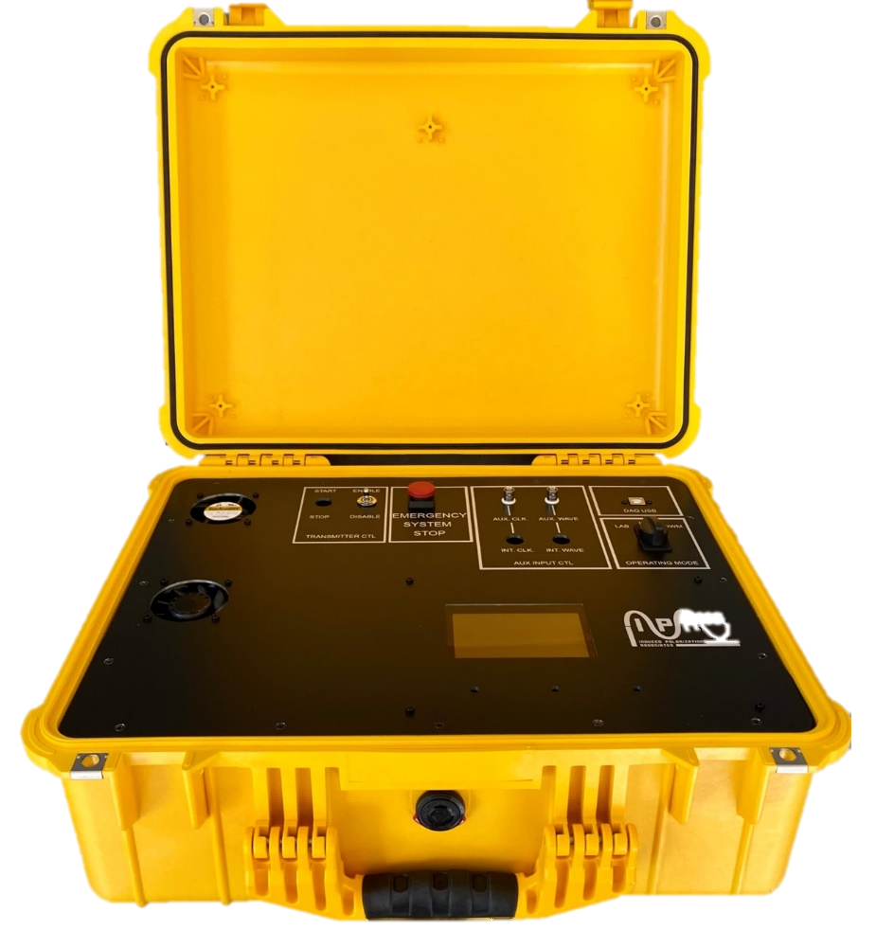
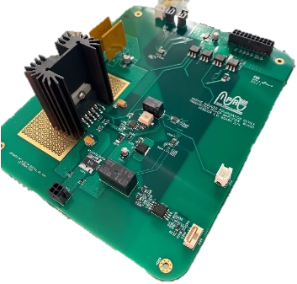
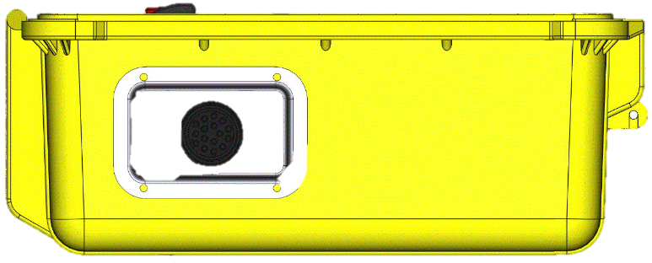
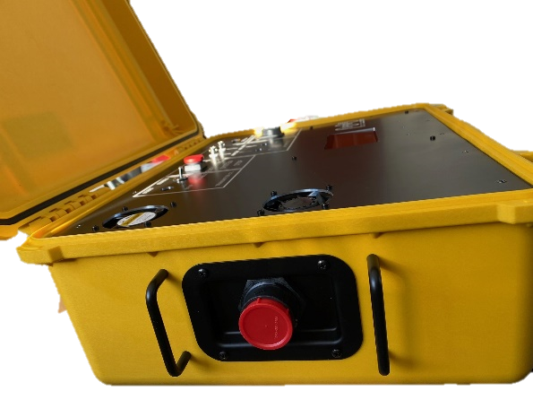
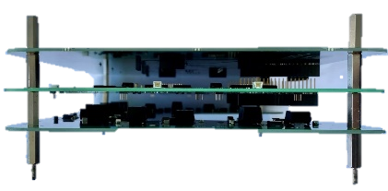
Marine IP: Progress on Milestones
ADAC Annual Meeting: 21 April 2022
Project Milestones – Hardware Designed and Built
  Fabricate prototype. Complete
Custom build of electronic boards complete.
Design.
Build.

Slide 9
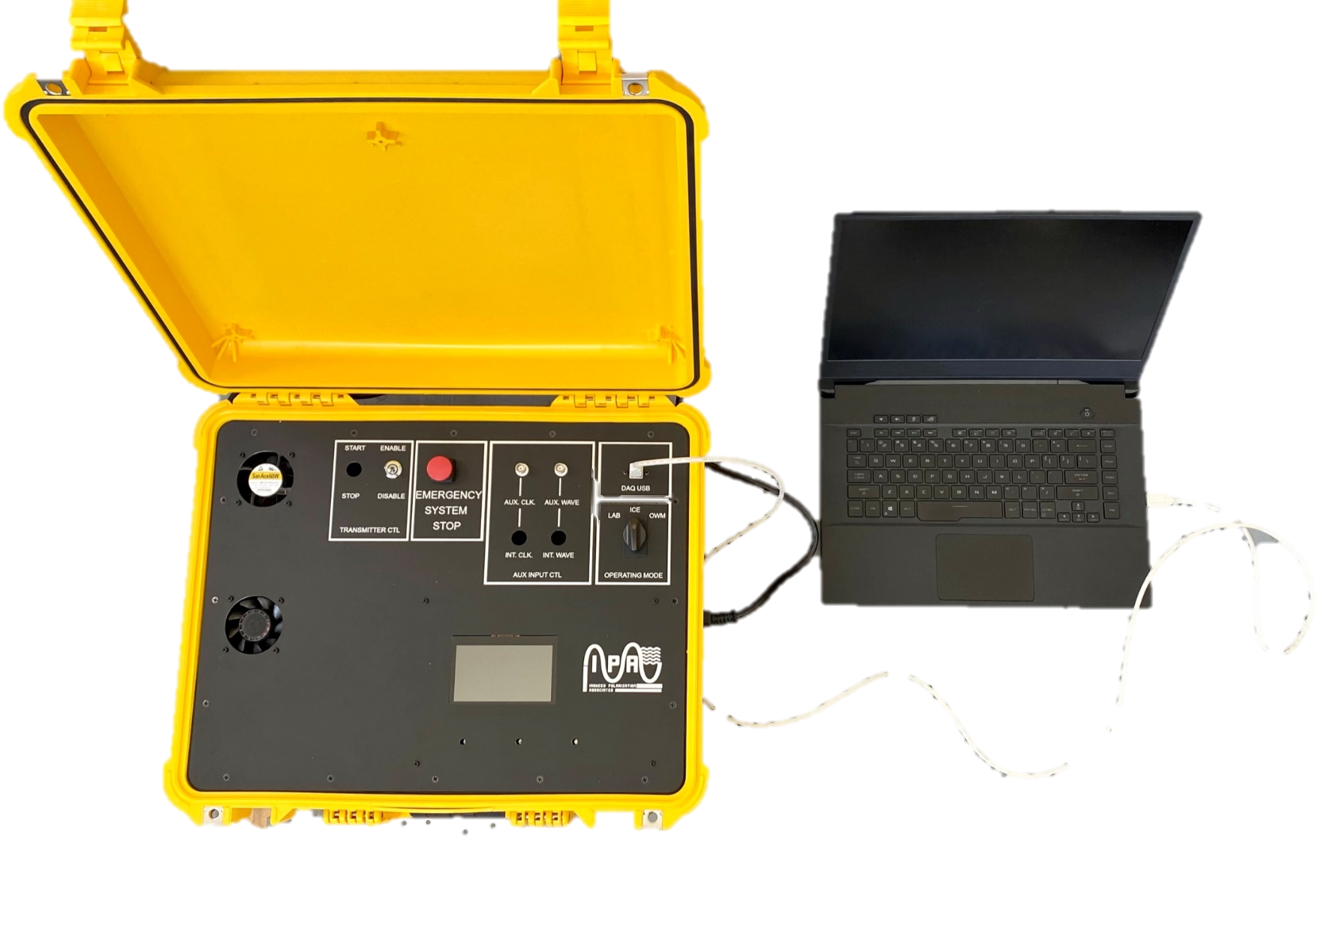
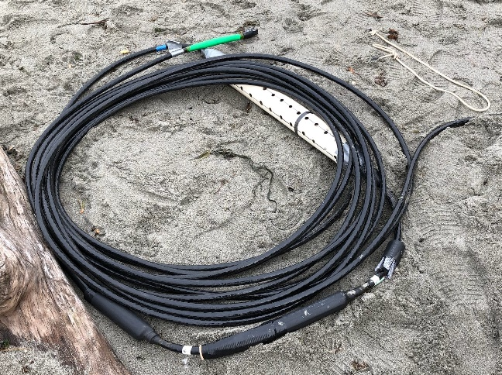
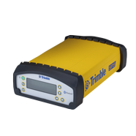
Marine IP: Progress on Milestones
ADAC Annual Meeting: 21 April 2022
New Marine IP Enclosure
  Fabricate prototype. Complete
Marine IP Cable
Laptop
GPS

Slide 10
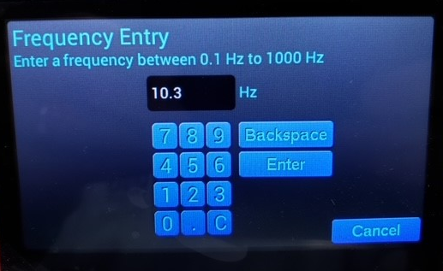
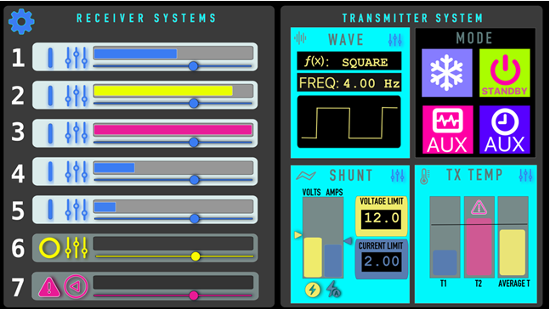
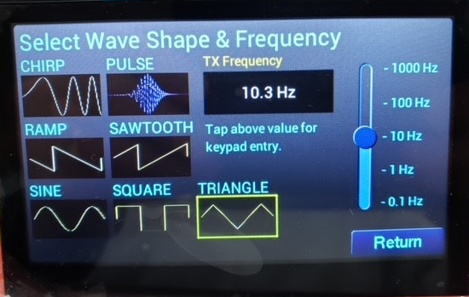
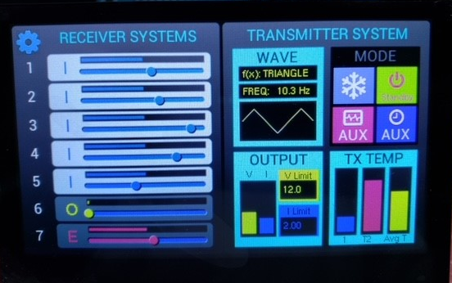
Marine IP: Progress on Milestones
ADAC Annual Meeting: 21 April 2022
Design and write prototype firmware. Complete
Firmware developed and undergoing small-scale laboratory tests and bug fixes. Complete
Display Interface: Design
Display Interface: Build

Slide 11
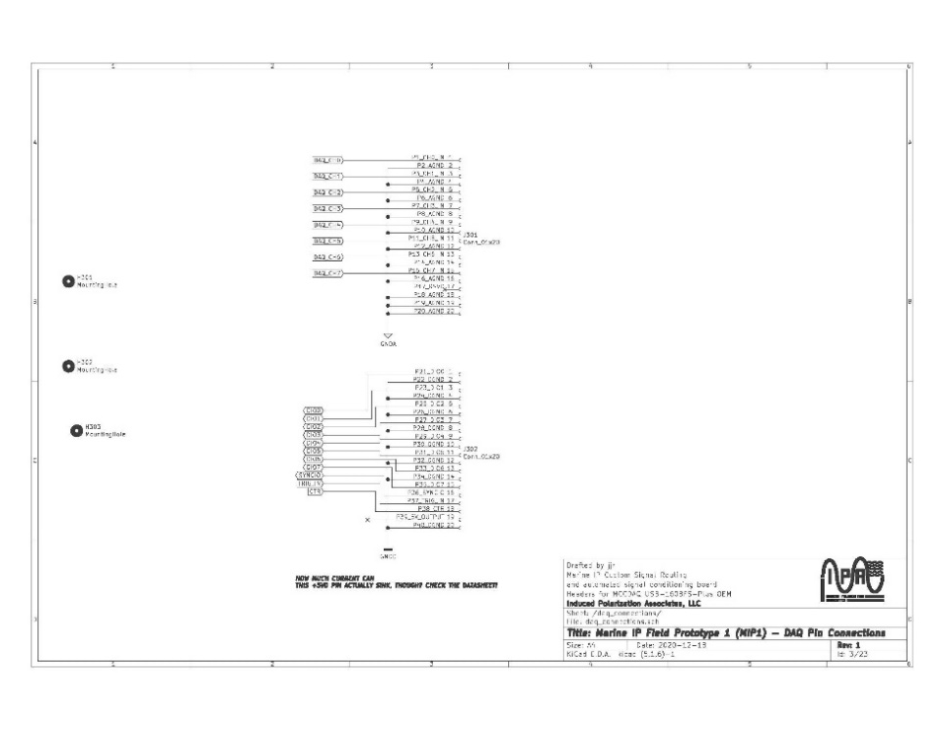
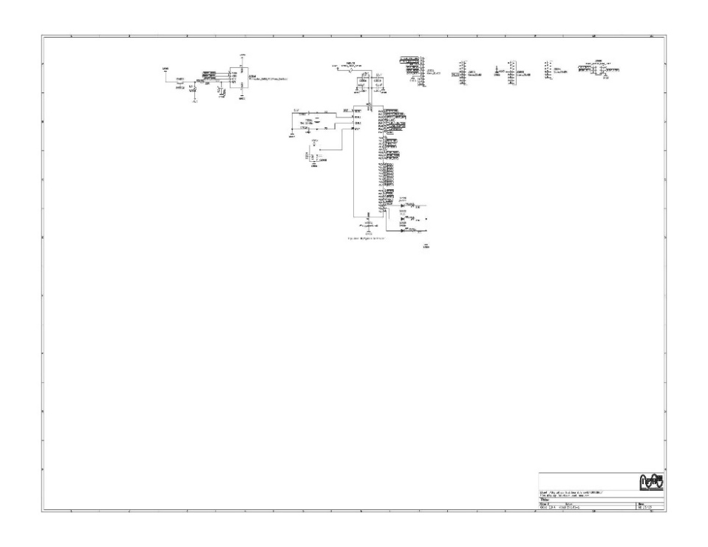
Marine IP: Progress on Milestones
ADAC Annual Meeting: 21 April 2022
Project Milestones – Software Design Complete
Engineering report outlining requirement and specification details. Complete
Develop a plan-design-implement-test-revise loop. Complete
Select a suite of core usage and testing cases. Complete
Design.

Slide 12
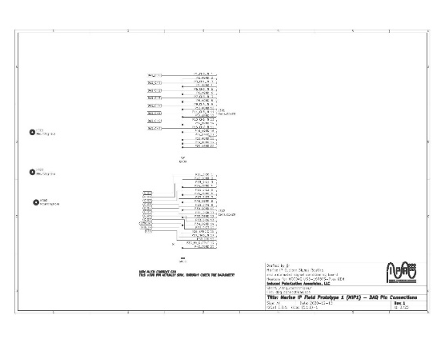
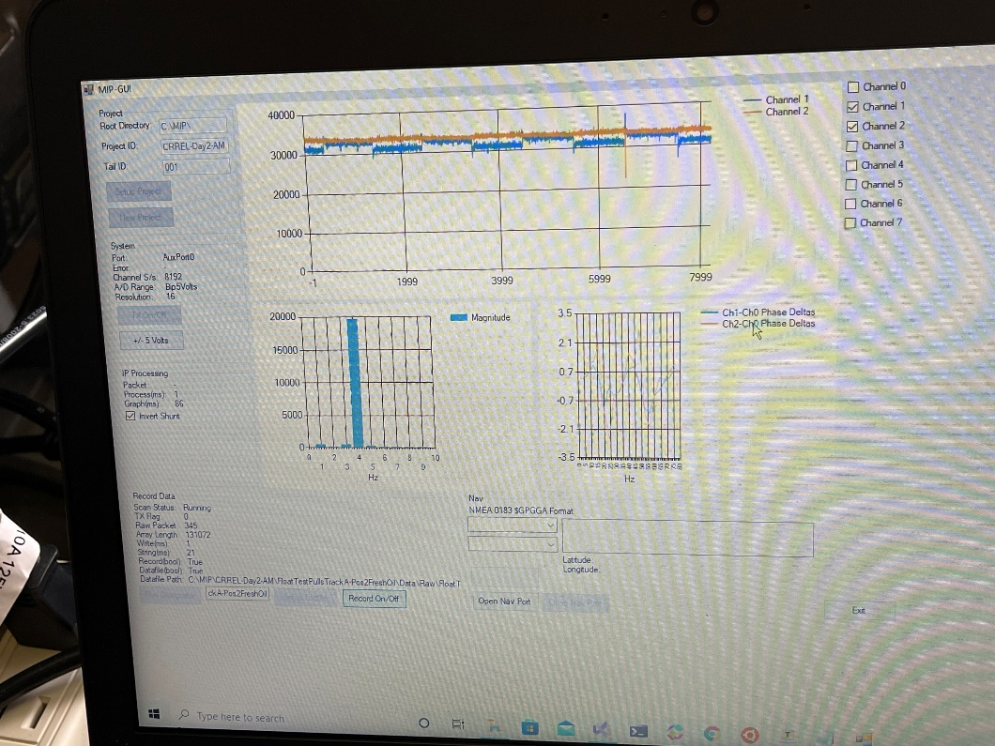
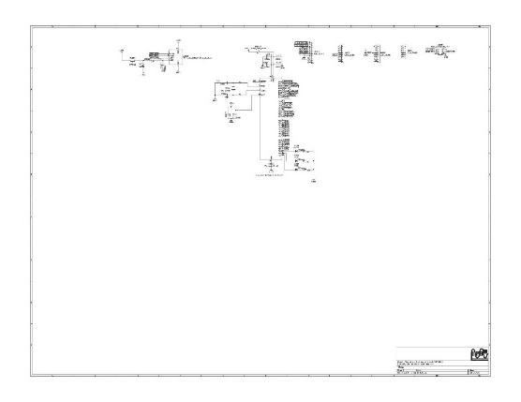
Marine IP: Progress on Milestones
ADAC Annual Meeting: 21 April 2022
Project Milestones – Software Build Complete
Mock-up a user interface and menu structure. Complete
Complete mockups of user interfaces and software control systems. Complete
Build.
Design.

Slide 13
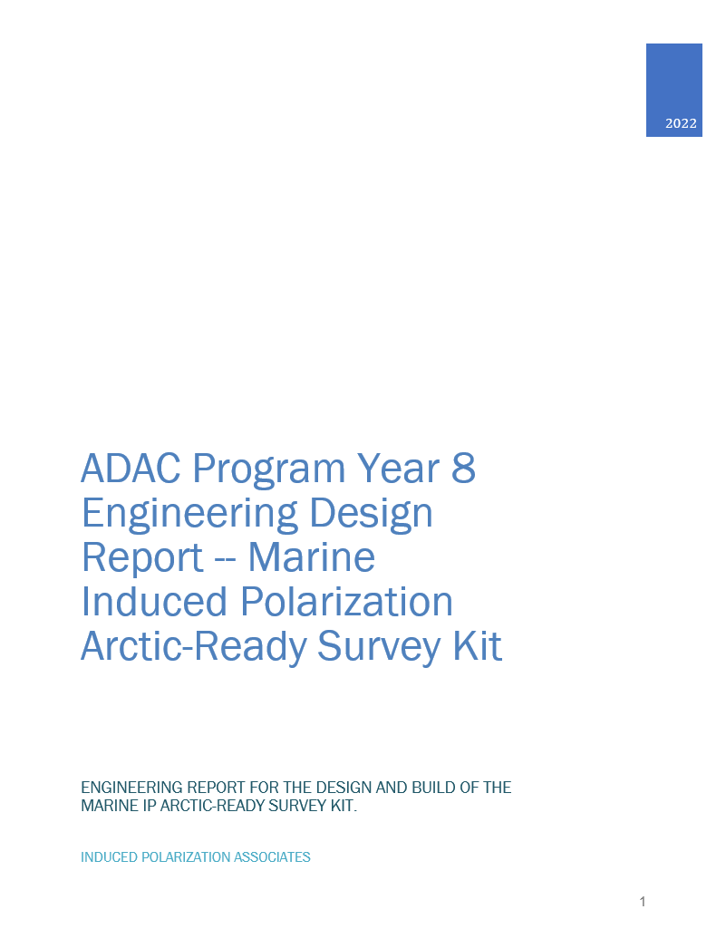
Marine IP: Progress on Milestones
ADAC Annual Meeting: 21 April 2022
Submit engineering report reviewing design, fabrication methods, construction, and initial performance reviews of hardware system. Complete

Slide 14
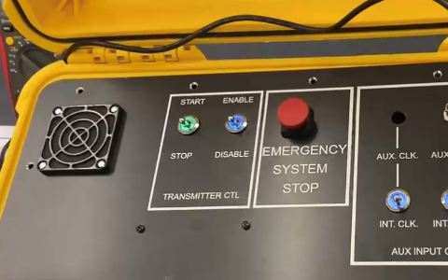
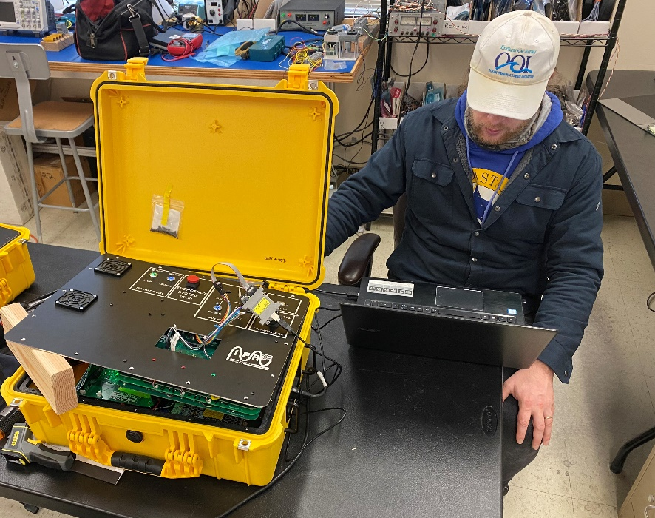
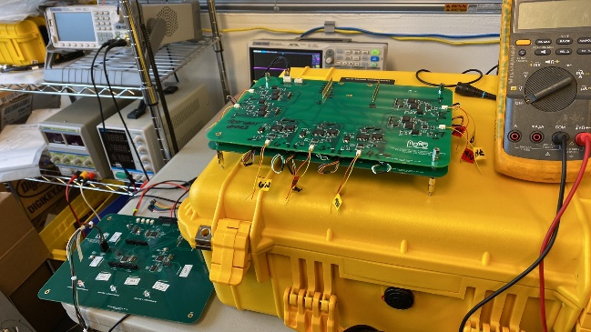
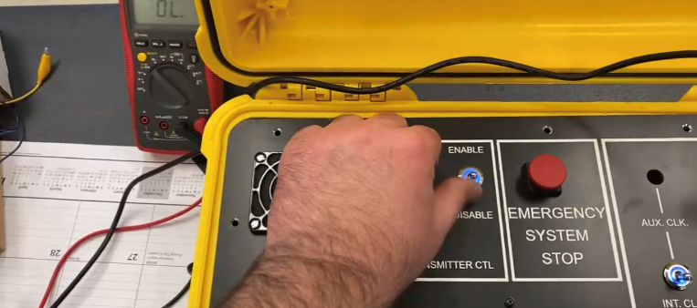
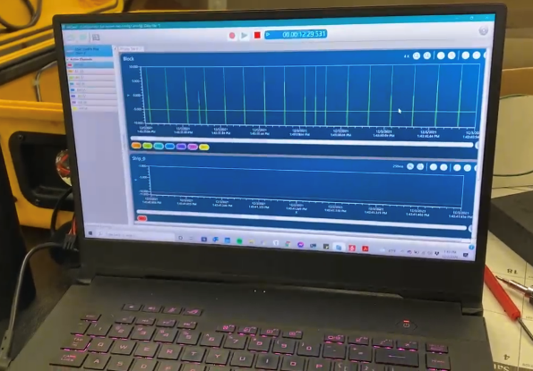
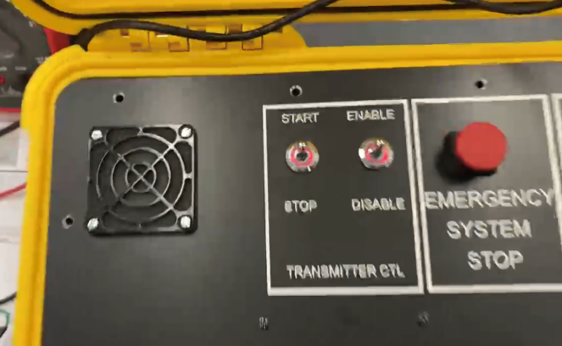
Marine IP: Progress on Milestones
ADAC Annual Meeting: 21 April 2022
Startup and initial performance and function tests. Complete
Complete performance and functional tests in laboratory. Complete

Slide 15
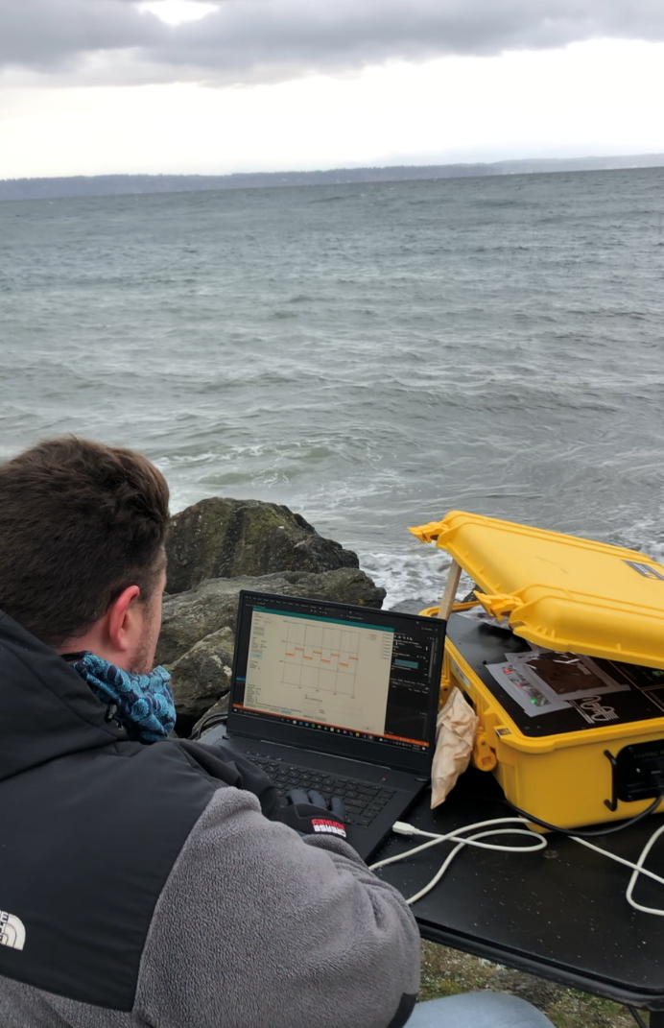
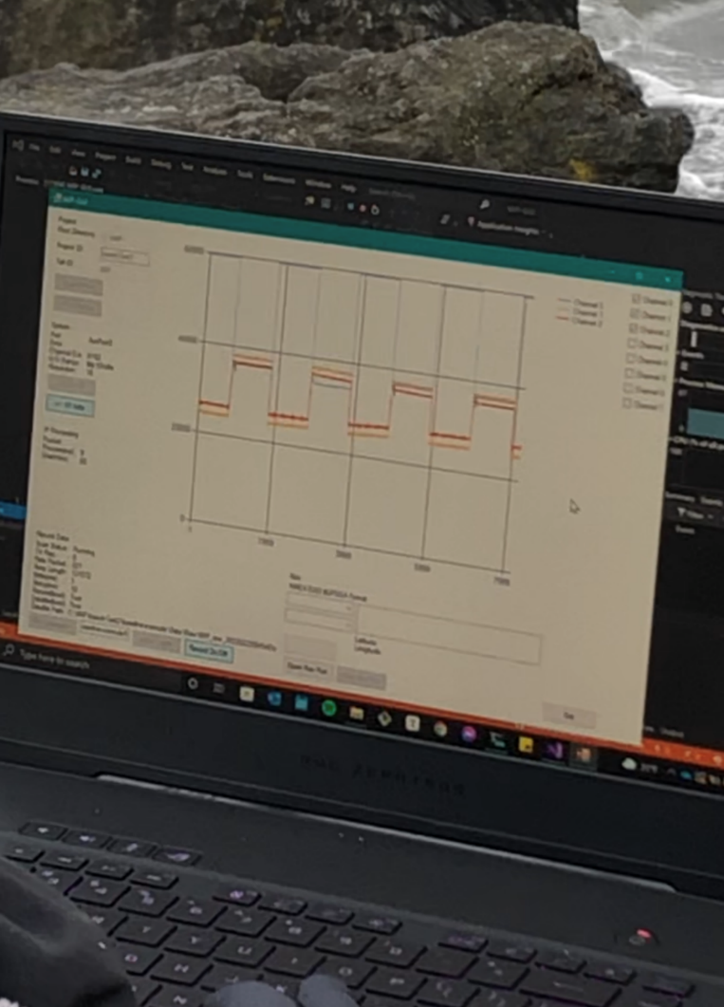
Marine IP: Progress on Milestones
ADAC Annual Meeting: 21 April 2022
Hardware: Beach testing of device and its integrations with the Marine IP cables. Complete

Slide 16
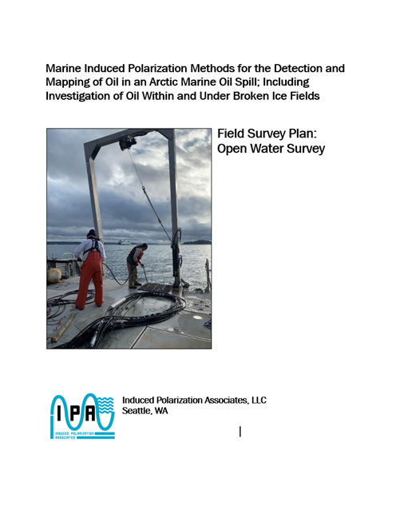
Marine IP: Progress on Milestones
ADAC Annual Meeting: 21 April 2022
Submit Field Test Plans for HQ USCG Project Champion review and approval. April 2022
  Demonstration planned for May 2nd with
  Coast Guard LCDR Clifton Graham and
  a NOAA representative in attendance.

Slide 17
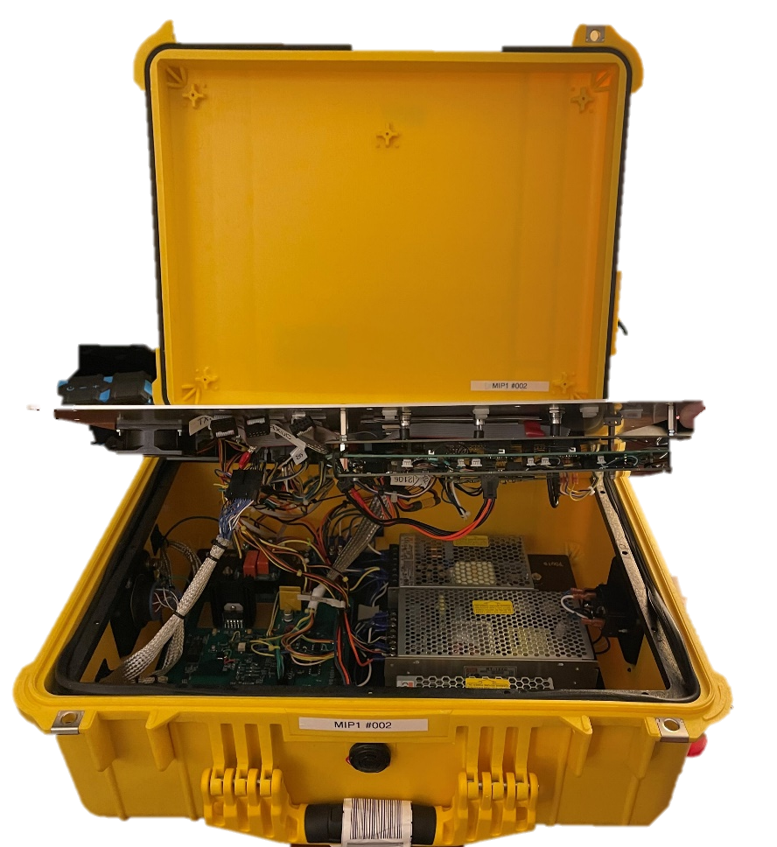

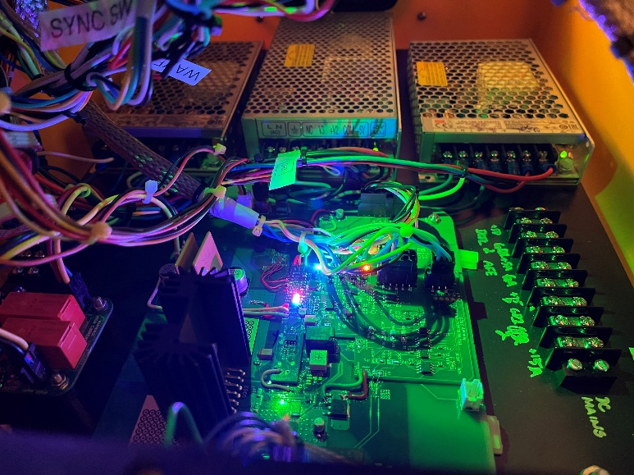

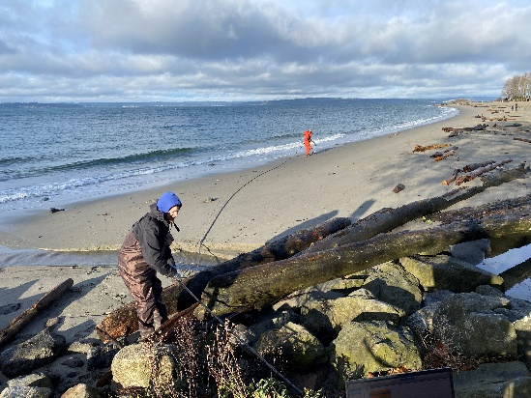
Marine IP: Progress on Milestones
ADAC Annual Meeting: 21 April 2022
Complete implementation of Arctic-Ready Marine IP System – Hardware, Software. Complete

Slide 18
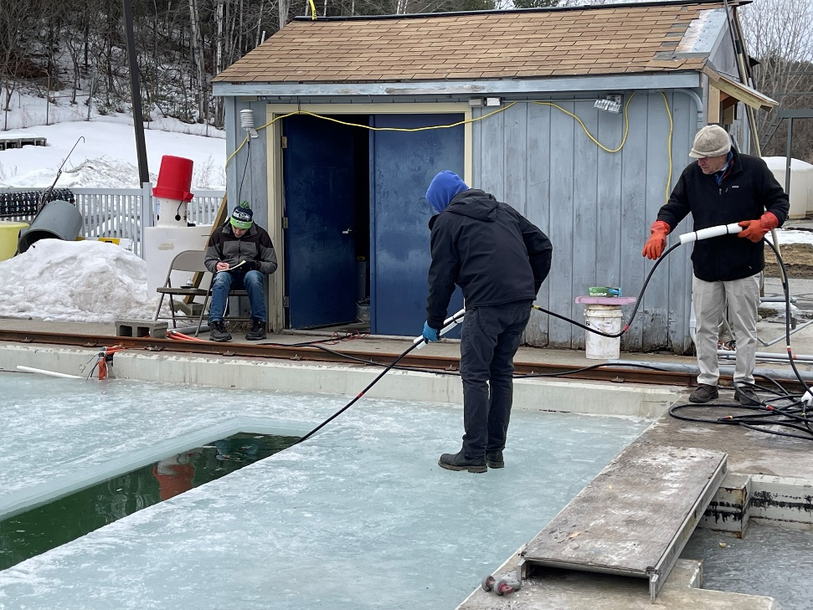
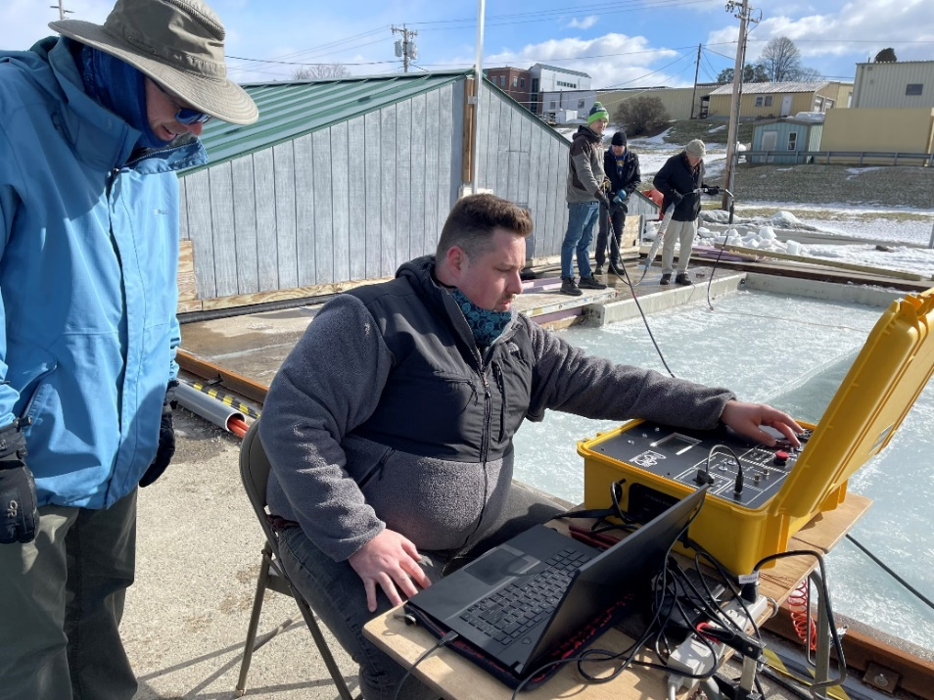
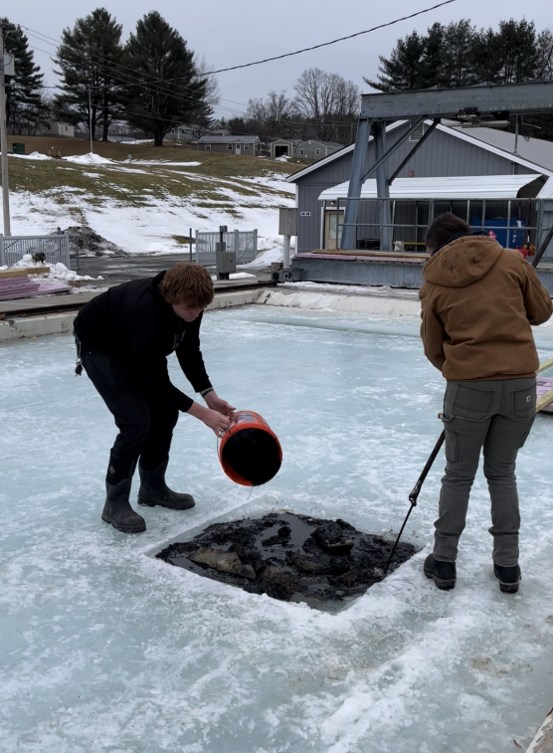
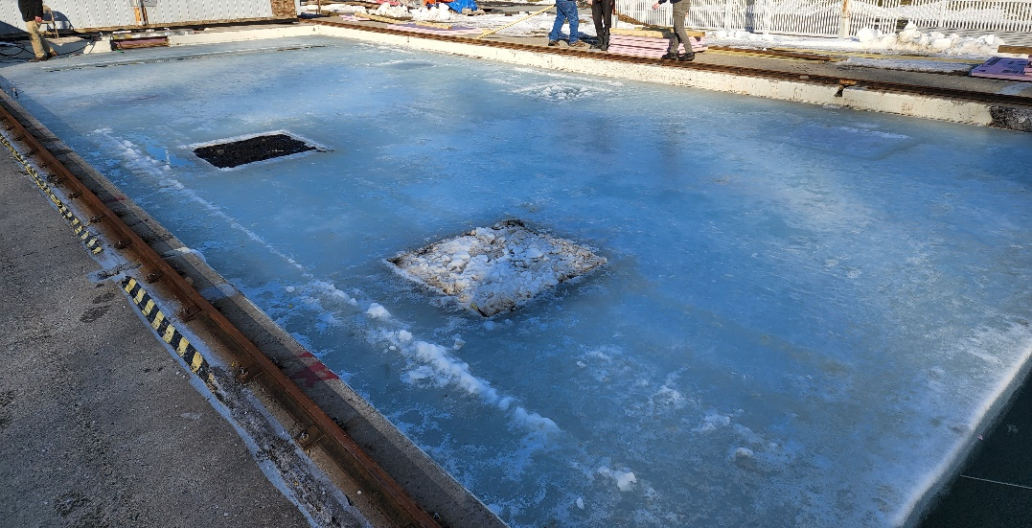
Marine IP: Progress on Milestones
ADAC Annual Meeting: 21 April 2022
Complete Field Trials of Arctic-Ready Marine IP System. Complete
Complete data analysis and reporting. April 30

Slide 19
Marine IP: Progress on Outcomes/Outputs
ADAC Annual Meeting: 21 April 2022
  Provide test plan for Arctic-Ready Marine IP System. Complete
Engineering Design Report: Provide advanced information for the design parameters for applications of Marine IP with an autonomous underwater vehicle (AUV). Complete
Arctic-Ready Marine IP System – Hardware: Provide a Marine IP measurement field kit designed for use in arctic conditions. Complete
Arctic-Ready Marine IP System – Software: Provide a new software interface for data collection using the Marine IP measurement field kit. Complete
Technical Report: Provide DHS with a report with all the results of this research that becomes publicly available. April 30
Peer-Reviewed Publications: Research team will produce draft peer-reviewed scientific publications from this project. Intended
Publicly Available Data: Researchers (in coordination with ADAC) will ensure all releasable data produced during this project is publicly available within 6 months of project conclusion. April 30 `

Slide 20
Marine IP: Student Contributions
ADAC Annual Meeting: 21 April 2022
Students did not contribute to this research
One full-time employee and one part-time employee support this project, driving cable design, build, and testing, as well as supporting data processing and analysis

Slide 21
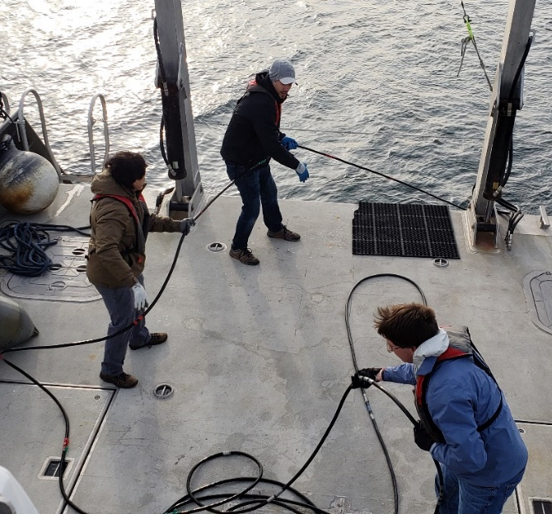
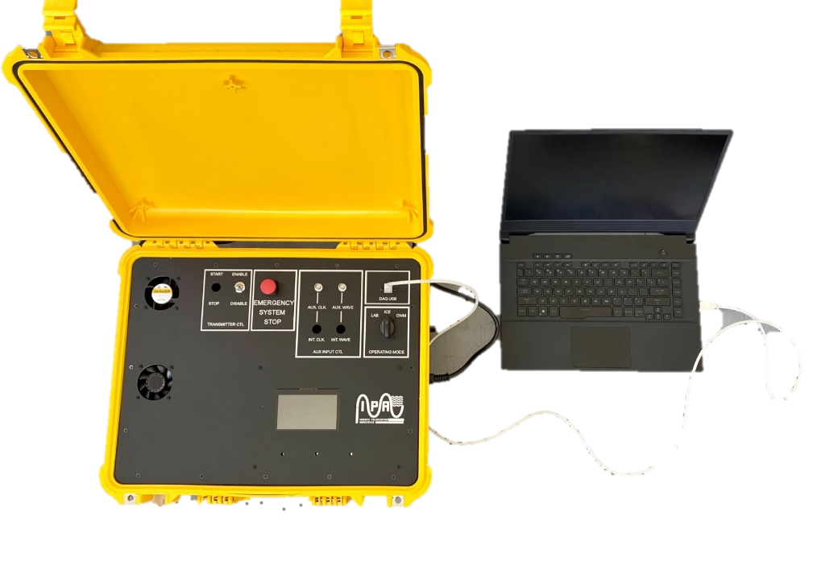
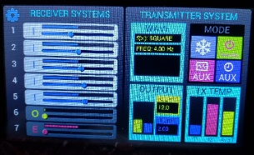
Marine IP: Update on Transition and TRL
ADAC Annual Meeting: 21 April 2022
The goal of this research is to demonstrate Marine IP technology in a relevant environment to enhance situational awareness for the USCG, DHS and other agencies relating to oil released in open or ice-laden water.
Steps to transition:
Demonstration of value and effectiveness for the USCG and other stakeholders through open water and simulated ice environment testing – ADAC Year 6 research.
Development of commercialized equipment, ruggedized for the Arctic environment – ADAC Year 7-8 research.
Develop a software interface suitable for USCG usage – ADAC Year 7-8 research.

Slide 22
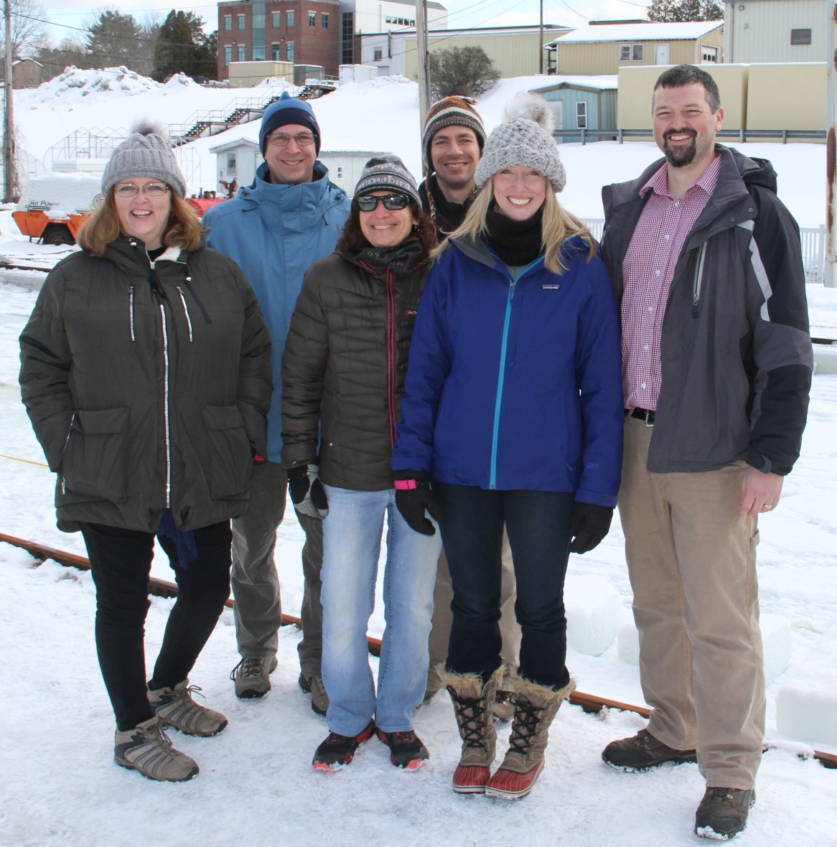
Marine IP: Next Steps…
ADAC Annual Meeting: 21 April 2022
Improved signal clarity
Improved post processing software
Testing range of oils
Autonomous operating system
Configure hardware for AUV and buoy deployment
Test in diverse environments
Test on the U.S. Coast Guard Cutter Healy
Questions?
Project team at CRREL during baseline testing.
From L to R: Karin Messenger (USCG), Scott Socolofsky (TA&M), Dana Tulis (USCG), Alexander Balsley (USCG R&D), Kari Walker (Marine IP), Nathan Lamie (CRREL)

